Slide 1
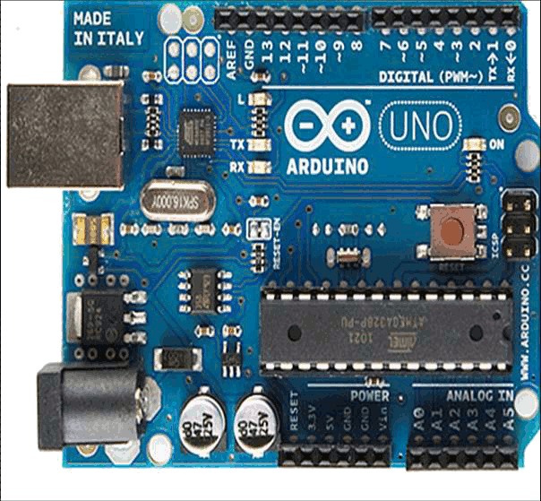
HackScience
Arduino (Genuino) tutorial
26-01-2016
Avi Braun
Notes:
Few words about my self:
Physicist; EXSS; IC research fellow.
Arduin since 2013
Arduino workshop
Succesful – pulm treee project;

Slide 2

Aim
Introduce Arduino to new users who wish to use it for lab application: what it is Arduino, what it is good for, how to use it, and how to develop your Arduino skills.
Learning outcomes – by the end of the workshop you will…
Understand how Arduino can be used for creative, technological and lab applications.
Know how to install and connect Arduino to your computer
Know how to use the Arduino development environment (IDE)
Understand the anatomyof the Arduino micro-controller
Be able to program your Arduino to read sensor(s), and to operate actuators according to logical conditions
Be familiarized with various sensors and actuators.
Know how to read/send data to/from your Arduino from your computer
Be familiarized with different options for remotely communicating with your Arduino
Be familiar with books and on-line resources that will allow you to further develop your Arduino skills

Slide 3
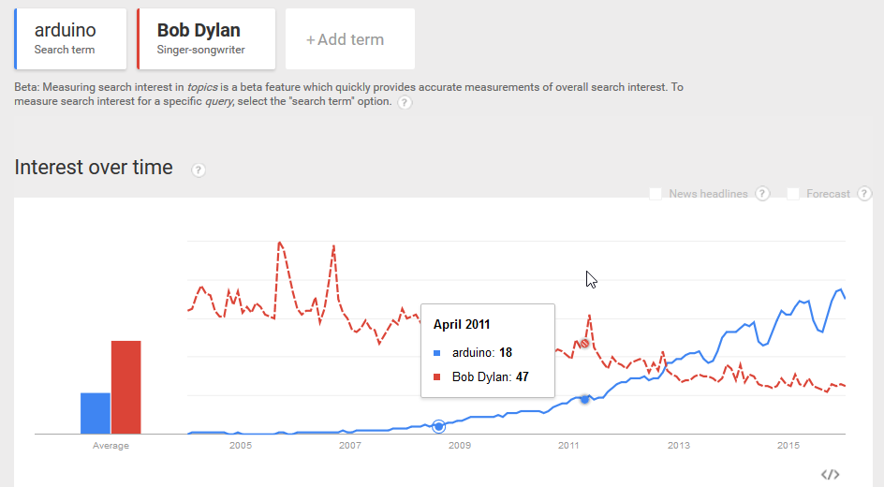
Introduction to Arduino
Notes:
These two photos are a good starting point for understanding what Arduino is:
A small, cheap and accessible controller that allows us to sense the environment, record it and actuate different elements according to our will.
Maybe the most extreme example for that is the ArduSat – the first satellite that runs on Arduino.

Slide 4
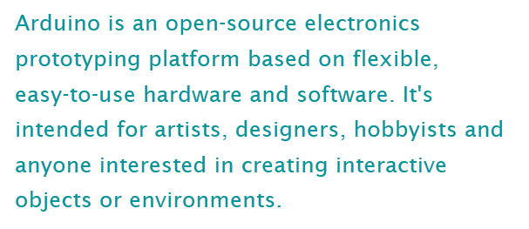
What is Arduino?
,Scientists
(www.arduino.cc)
Arduino is a tool for making computers that can sense and control more of the physical world than your desktop computer.

Slide 5
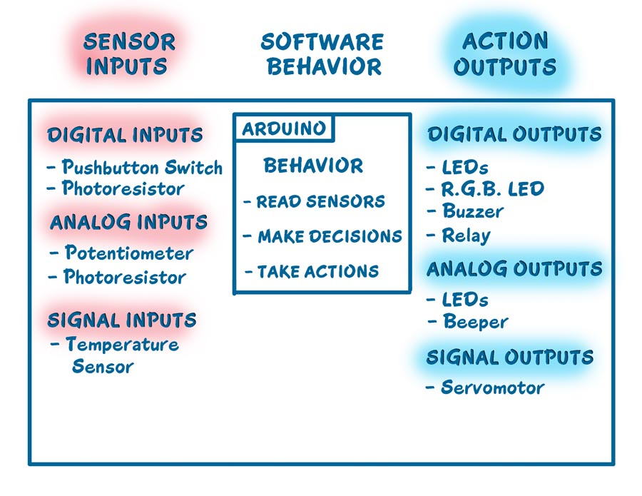
What is Arduino?
Microcontroller + Development environment)
Computer: core processor, memory, clock generator, programmable Input/Output peripherals

Slide 6

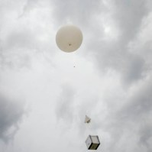
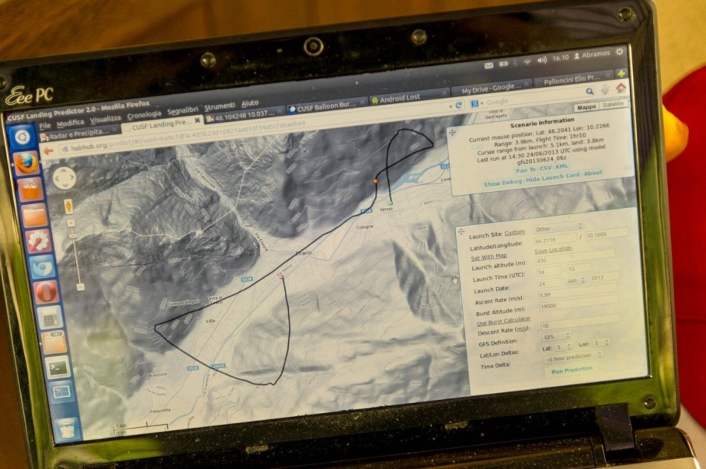
Arduino monitored High Altitude Balloon

Slide 7
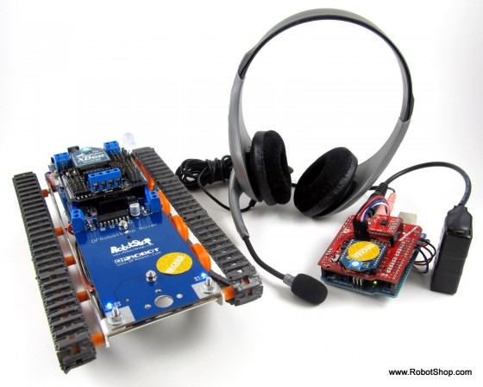
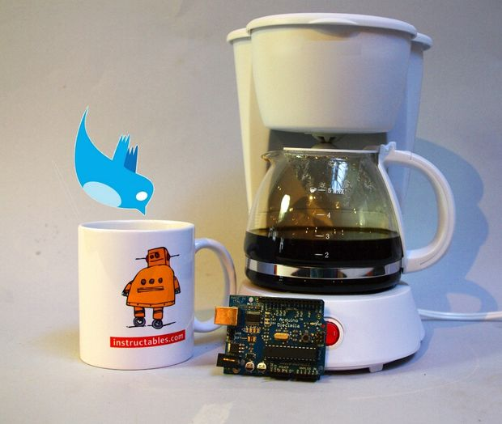
Speech-Controlled Arduino Robot
Tweet-a-Pot: Twitter Enabled Coffee Pot

Slide 8
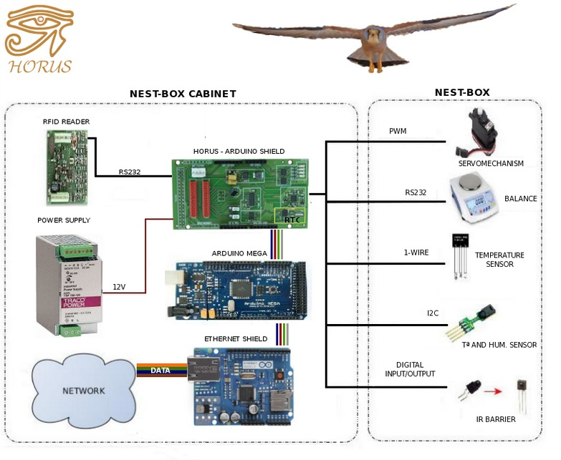
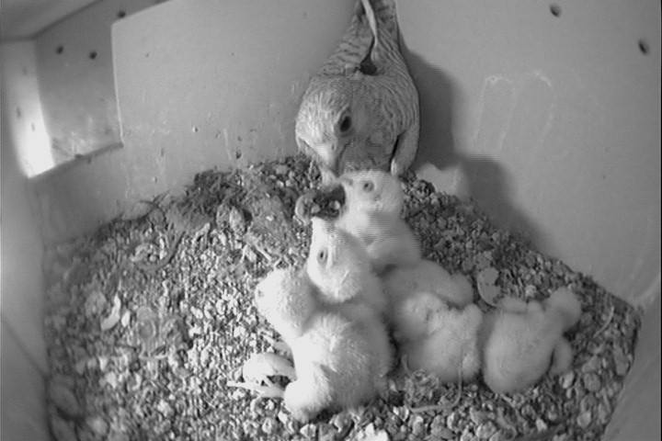
Smart nest
Smart nest

Slide 9
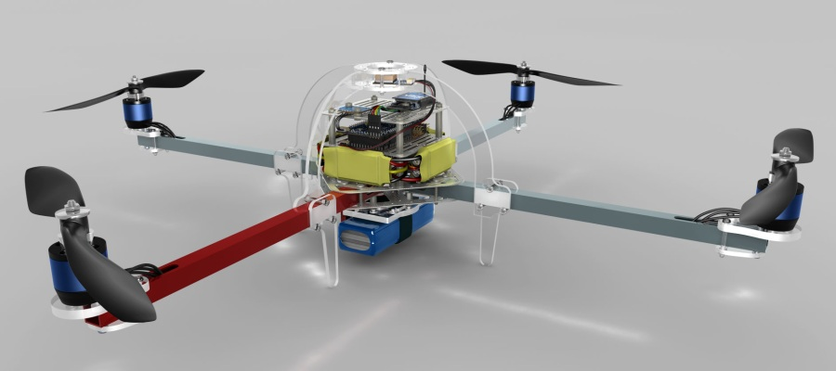
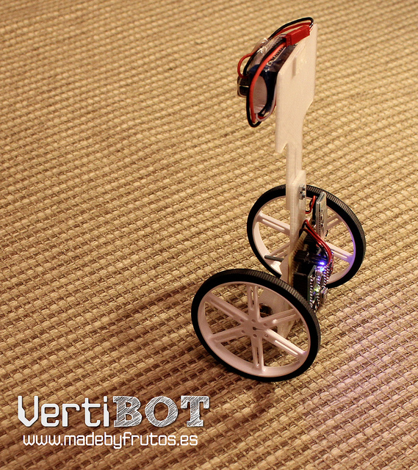
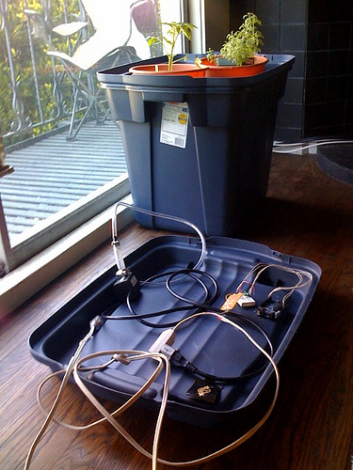
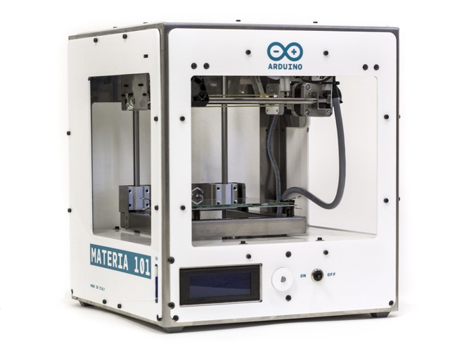
Home automation
Growduino
3D printers
Robots (autonomous and actively controlled)

Slide 10
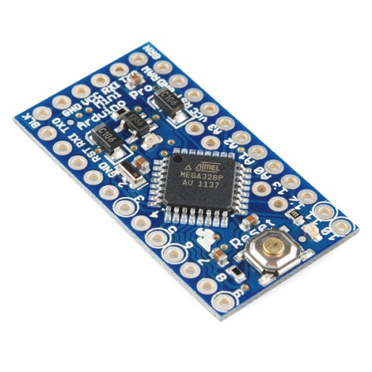
Advantages
Ready and easy to use:
USB connection
Power plug
Low cost: starting at $ 9.95 per piece
Open source
“…people should be able to study our hardware to understand how it works, make changes to it, and share those changes...” (www.arduino.cc)
Accessible:
A lot of documentation, tutorials for beginners (and experts)
Modules and shields – adding capabilites (hardware) to your Arduino

Slide 11
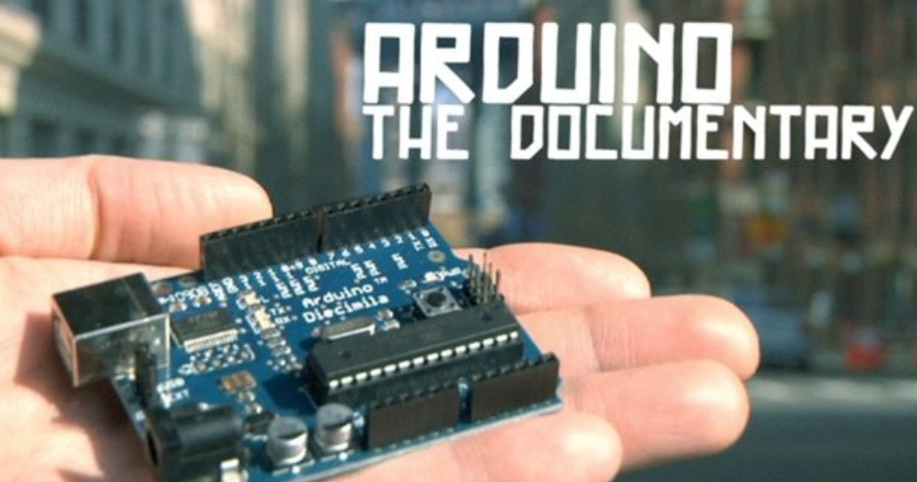

A brief history of Arduino

Slide 12
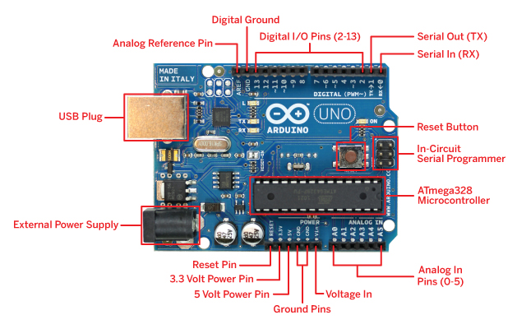
Arduino (Uno) Board Overview
Integrated LEDs:
Pin13
TX
RX
Serial communication
7-12V
10 bits
I2C (Inter-Integrated Circuit) and SPI (Serial Peripheral Interface)
5V/3.3 V

Slide 13
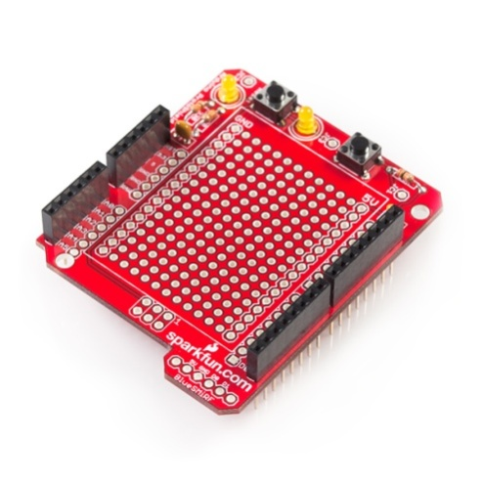
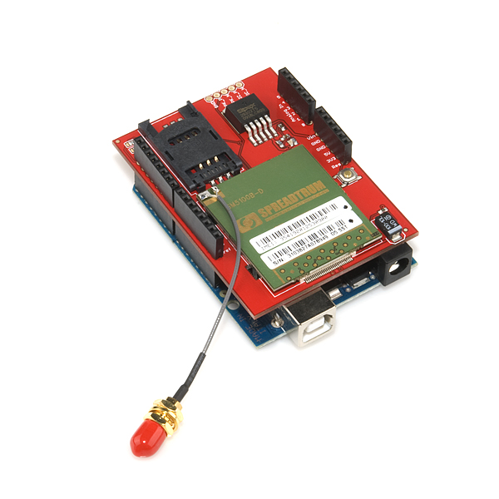
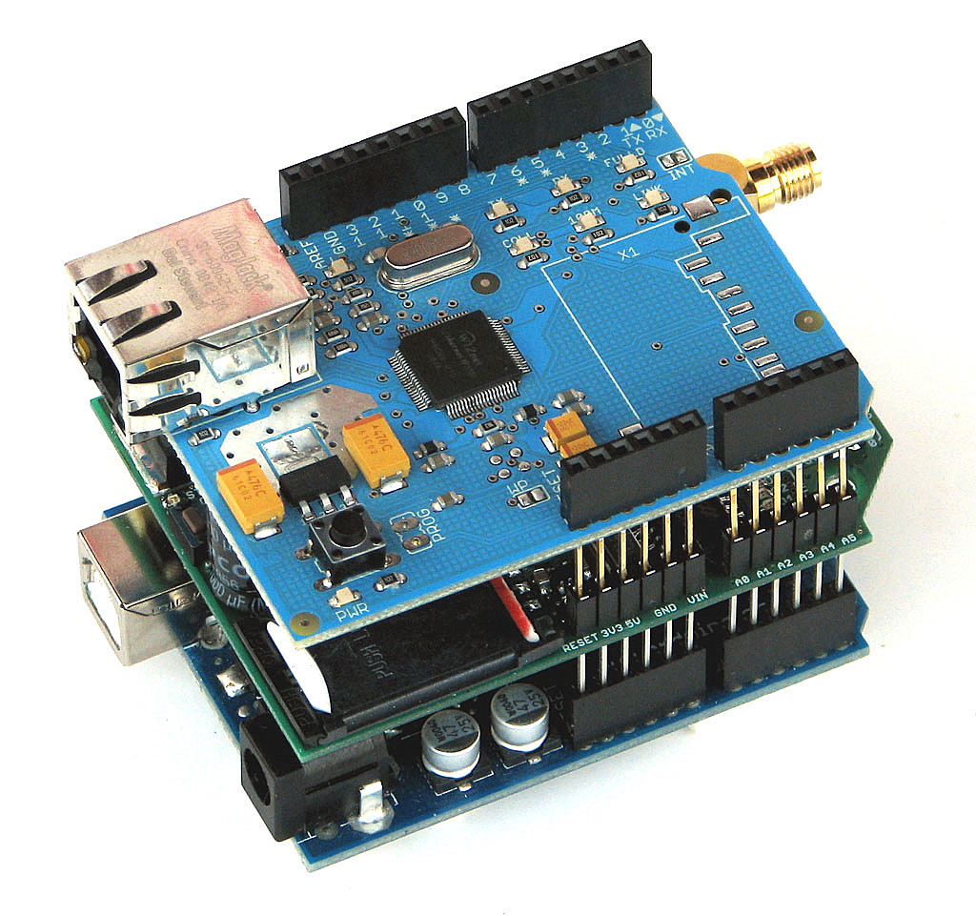
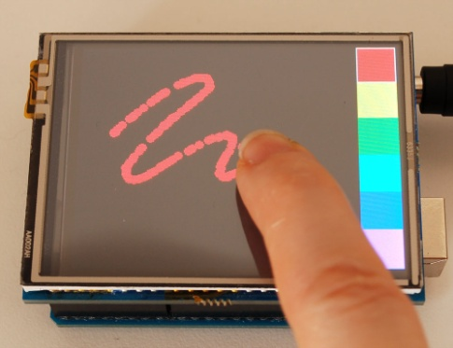
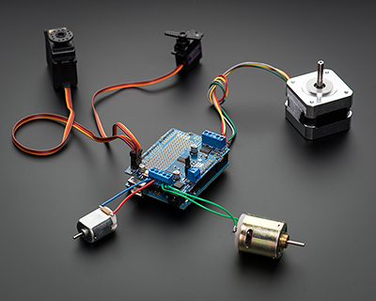
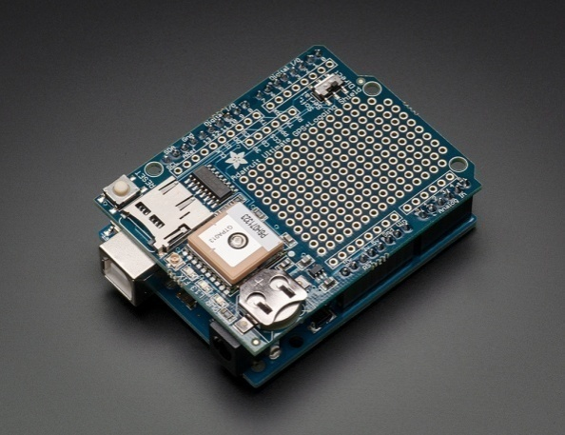
Shields and modules
Adding hardware capabilities to the Arduino board:
GPS
SD card
Real Time Clock
Displays: LCD, touch screens
Motors: Servo/DC/Stepper
Prototype
Camera
Joystick
Notes:
Microcontroller: avaliable components

Slide 14
Shields and modules
Communication:
Bluetooth
Cellular: GSM/GPRS and others
Ethernet/wifi
Xbee
RFID
Adding capabilities to the Arduino board:
GPS
SD card
Real Time Clock
Displays: LCD, touch screens
Motors: Servo/Dc/Stepper
Prototype
Camera
Joystick
Notes:
Microcontroller: avaliable components

Slide 15
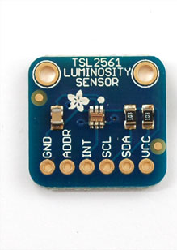
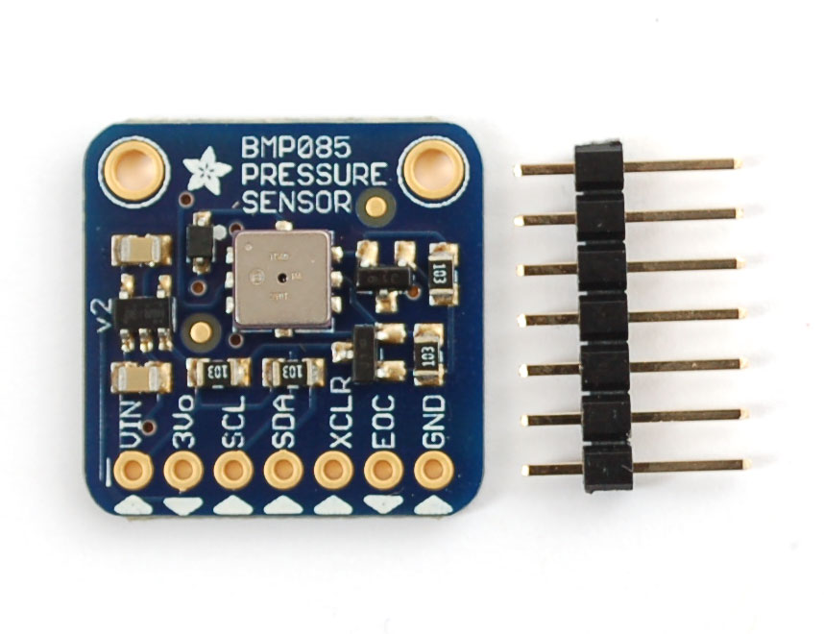
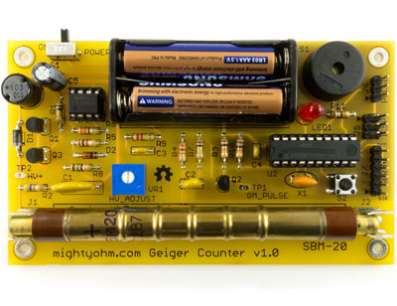
Shields and modules
Sensors and other modules:
Environment: Temperature, pressure, humidity
Geiger counter
Sounds
Movement: accelometer
Proximity: ultrasonic/IR/reflection
Biometric: finger prints/heart pulse
Light and colors
Flow
Force: pressure/bending
Extended ADC: e.g. 18bits
Notes:
Microcontroller: available components

Slide 16
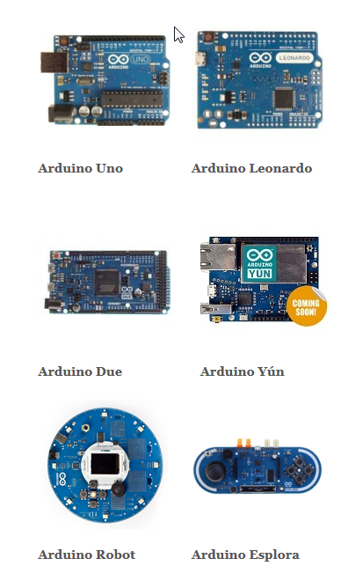
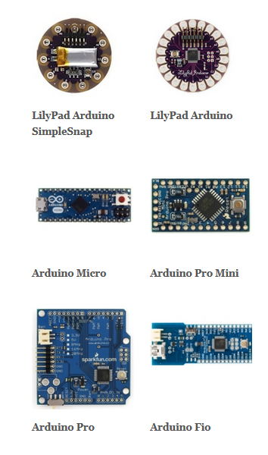
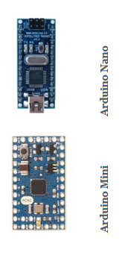
Meet the greater family

Slide 17
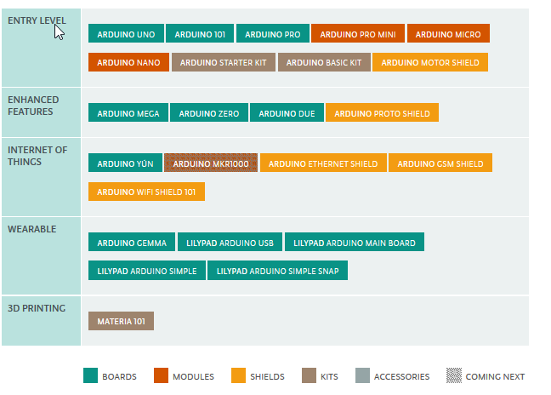
https://www.arduino.cc/en/Main/Products

Slide 18
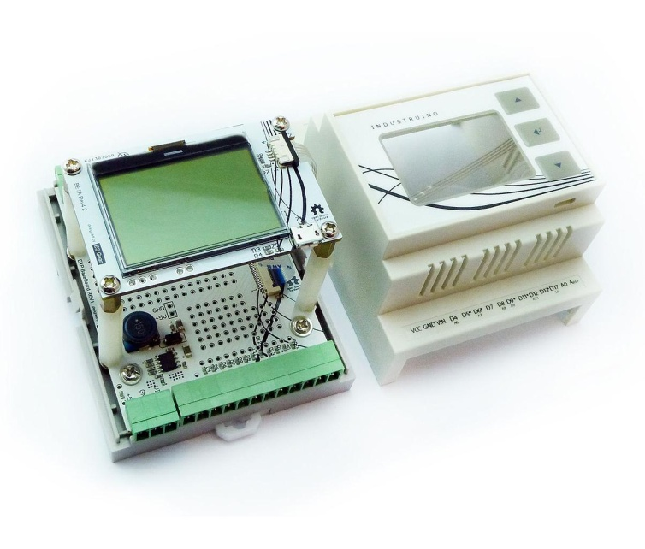
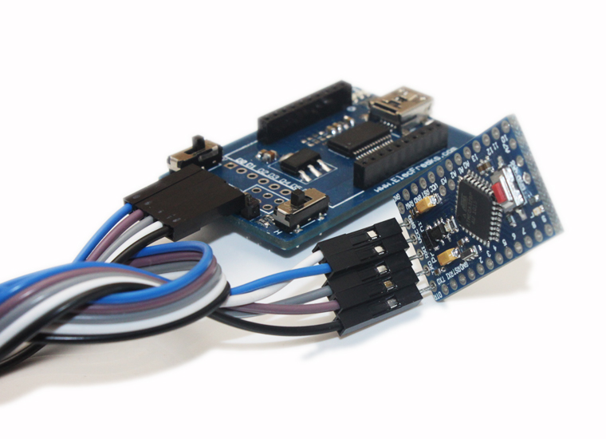
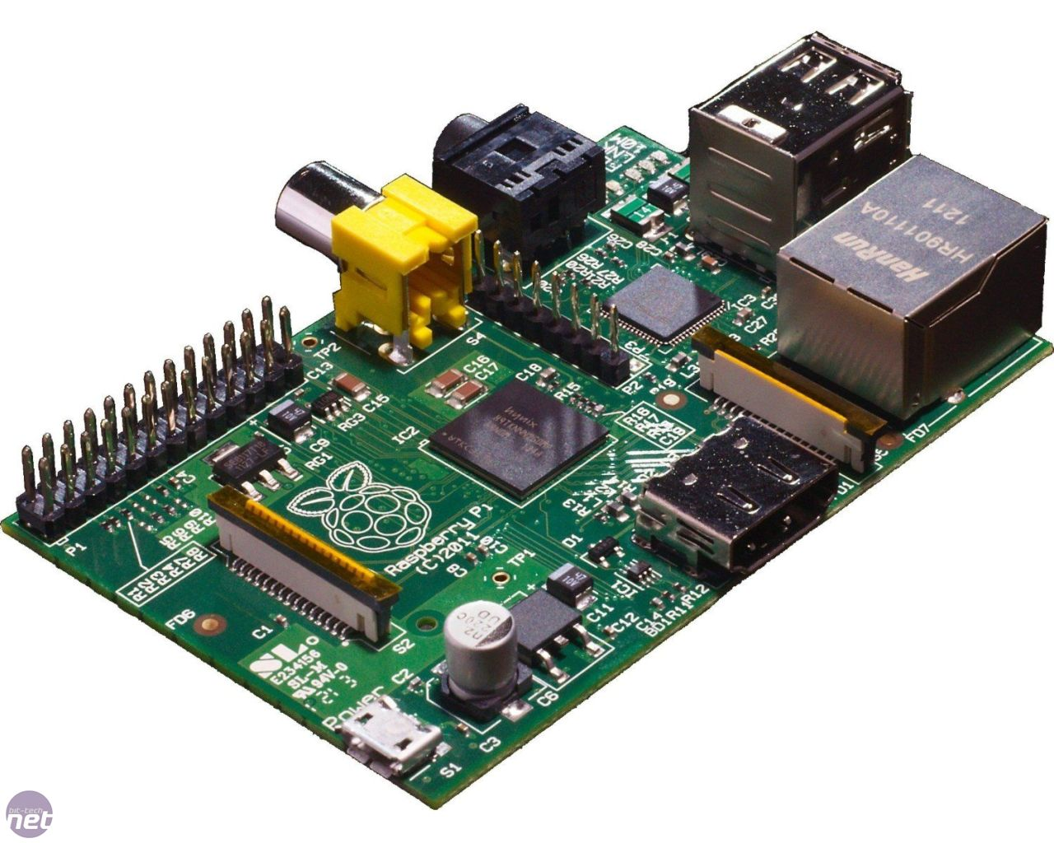
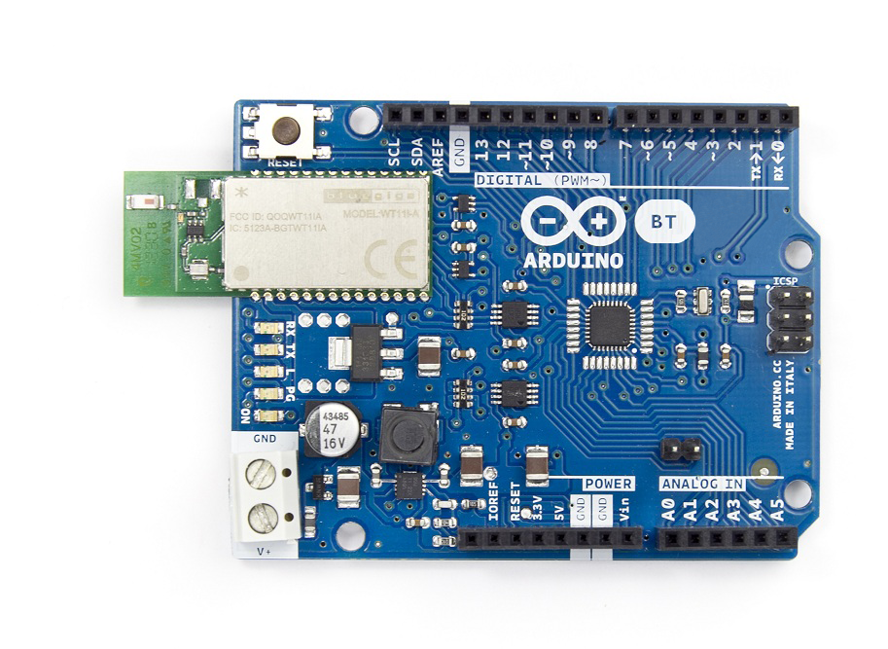
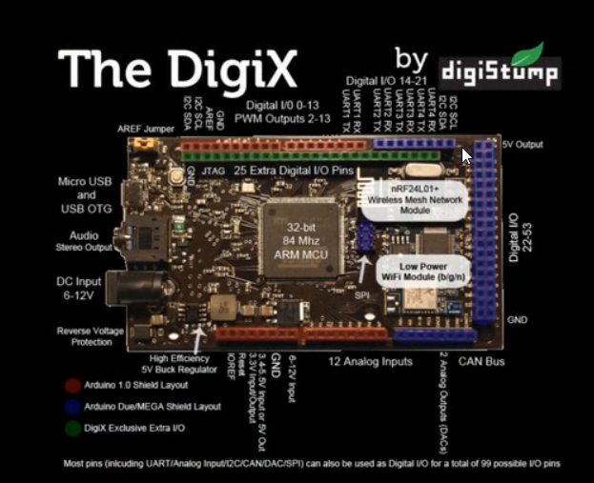
Raspberry Pi
https://industruino.com/shop/product/industruino-proto-kit-8
OtherDuinos
http://en.wikipedia.org/wiki/List_of_Arduino_compatibles

Slide 19
Why Arduino?
Simple, clear programming environment
Open source Extensible: both hardware and software
Inexpensive
Cross-platform – windows, mac OSX, Linux
For scientists:
Science and engineering education
Control your experiments environment
Sensing and measuring experiment
Data logging
Accessible

Slide 20
?

